Slide 1





Project Kick-off
Presentation
20-May-2022
A SEI-CMMi Level-5 Global IT Consulting & Software Solutions Provider
www.neosofttech.com
sales@neosofttech.com
+91 22 40500600

Slide 2
Agenda
Project Overview / Scope
Solution Architecture
Functional Implementation
Work Breakdown Structure
Project Timelines
Implementation Methodology
Project Schedule
Risk & Dependencies
Key Assumptions & Constraints
Deliverables
Communication Plan
Governance Model
Escalation Procedure
Q & A

Slide 3

Project Overview/ Scope
Client Pharmaceuticals wants to develop a web application to manage the New Product development. Client Group has an existing application - NPD (New Product Development) that is built using .NET technology. The current application is limited to the use of Tillomed (a group company of Client). The proposed application will be built in a multi-tenant architecture which will allow the employees of the other group companies within Client Group to access the new application with enhanced features.
The platform will have below entities and interfaces:
Administrator – Web Panel
User – Web Panel
Relevant Department User – Web Panel
Finance User – Web Panel
Management User – Web Panel

Slide 4
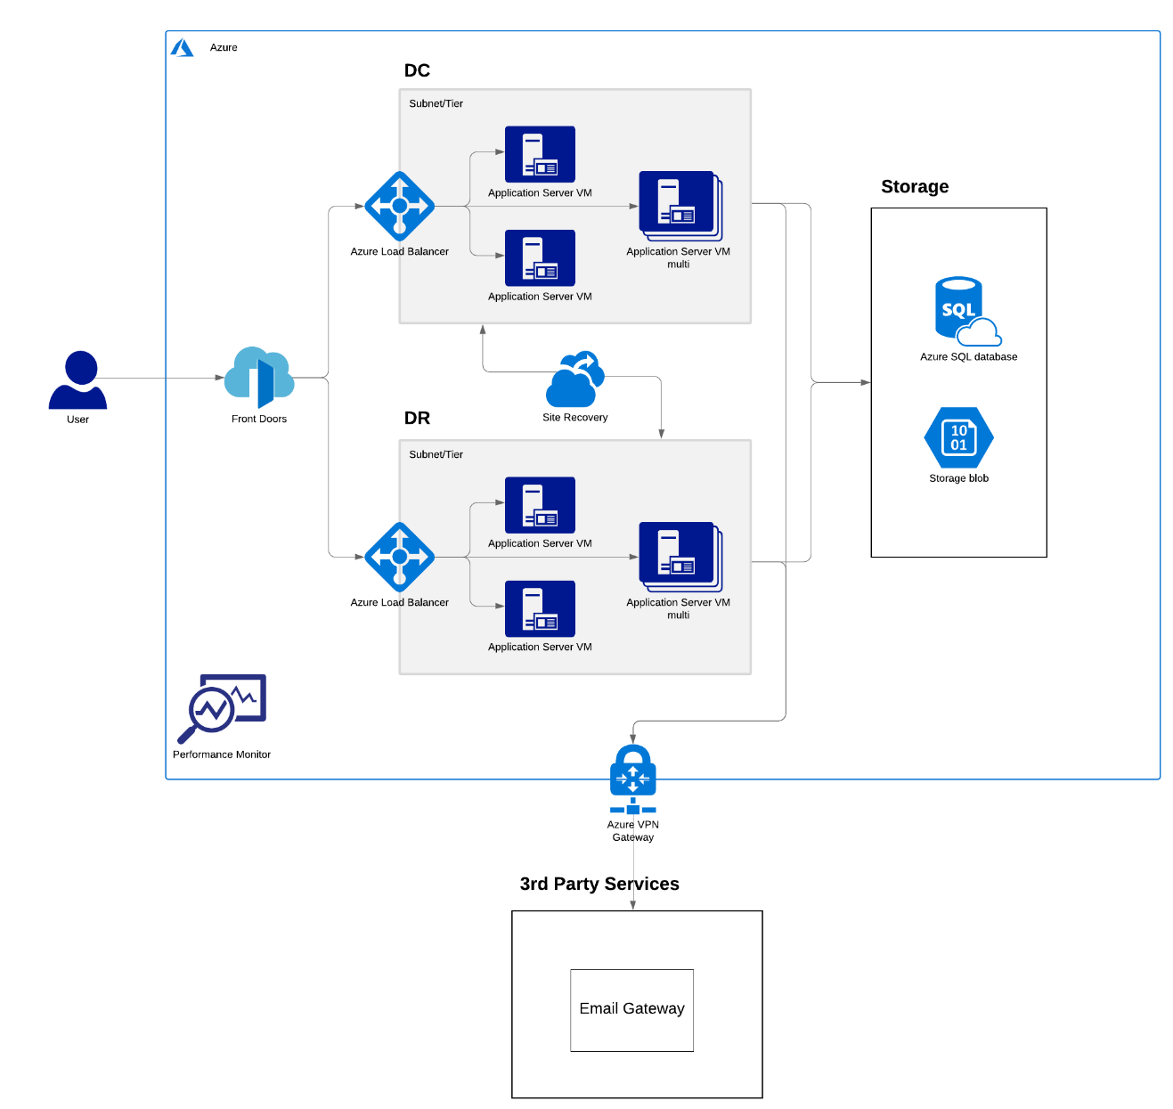
Solution Architecture
Note: It may need some revision basis
on requirement analysis (BA) phase.

Slide 5
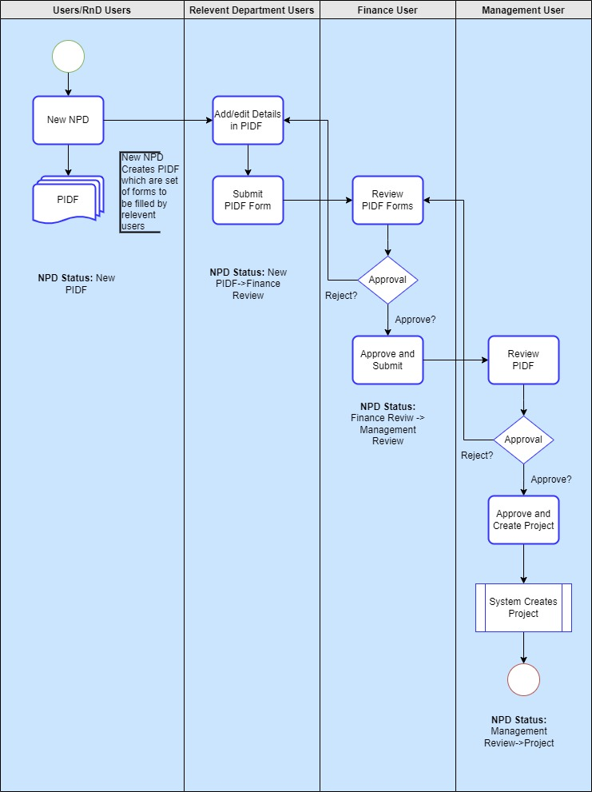
Functional Implementation

Slide 6
Work Breakdown Structure
Sr No. | Interface | Modules/Sub Modules
1 | Common Modules | Project Setup
2 | Administrators [Web] | Environment Setup and Database Design
3 | User [Web] | Design Integration
4 | Relevant Department [Web] | Role-based access control setup
5 | Finance User [Web] | Suggested - SSO based login
6 | R&D User [Web] | Login/ Logout
7 | Management User [Web] | Logout
 |  | Forgot password/ Password Setup
 |  | Dashboard
 |  | Roles
 |  | Master Management
 |  | Projects
 |  | NPD List
 |  | PIDF list
 |  | Dossier Management
 |  | Dossier Versioning
 |  | PIDF Forms
 |  | Management Approval
 |  | Project Creation
 |  | Gantt Chart Creation

Slide 7
Project Timelines
Activities | Week 1 | Week 2 | Week 3 | Week 4 | Week 5 | Week 6 | Week 7 | Week 8 | Week 9 | Week 10 | Week 11 | Week 12 | Week 13 | Week 14 | Week 15 | Week 16 | Week 17 | Week 18 | Week 19 | Week 20 | Week 21 | Week 22 | Week 23 | Week 24
Requirement Analysis
Solution Architecture
Database Designing
HTML Development
Dot NET Development
Testing
DevOps
UAT Period
UAT Sign-off
Production Deployment
Training

Slide 8
Delivery Methodology – Hybrid Waterfall Model
Requirement Gathering Phase: All requirements will be analyzed and signed off
Change Management Process: Any new additional requirements identified as part of the iterative releases will be considered as change
Each Iteration: It will have multiple releases which comprises design, development, and testing phases
Iterative Delivery Approach: Early access is provided to client during SDLC ensuring the app is being developed as expected using Hybrid Approach
Core application is built, and components are added to it as part of each sprint, permitting gradual implementation
After completion of all models, integration testing and subsequently final build will be available for customer UAT
Requirements
Design
Implementation
Feedback
Test
Scrum
Deploy
Verification
Single Sprint
Design
Build
Maintenance

Slide 9
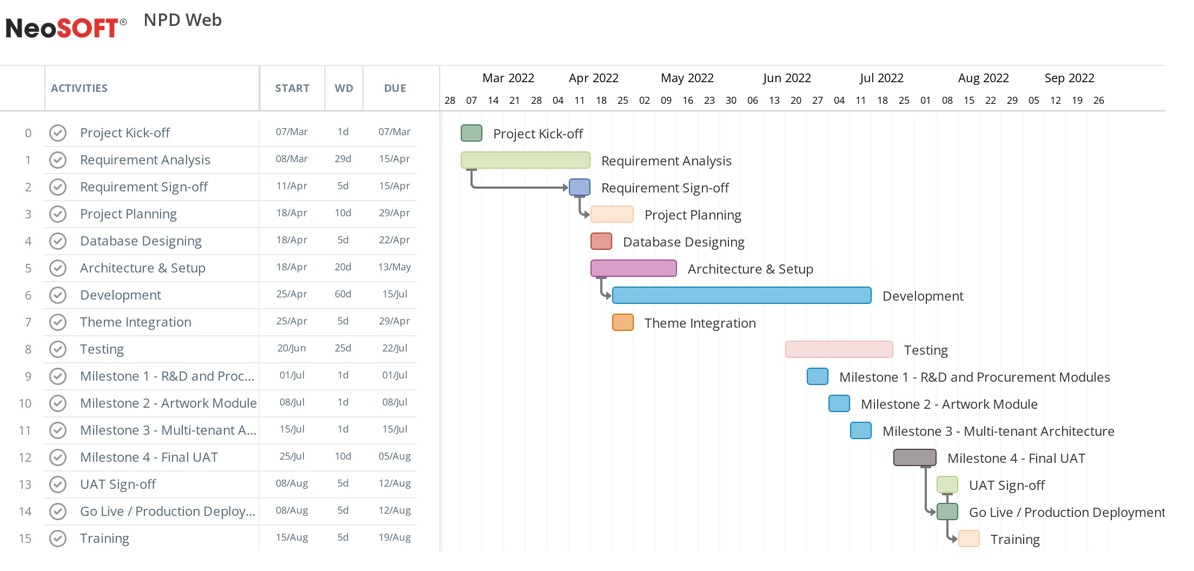
Project Schedule
Note: This is a tentative schedule. Once the requirements are baselined, the actual project schedule and dates shall be submitted.

Slide 10
Deliverables
Requirement Gathering
SRS
Wireframes
Design
Theme Finalization & Integration
Project Execution
Project Plan
Project Monitoring Artifacts
Risk Analysis
Development / Implementation
Application Build
QA
Test Plan
Test Cases / Report
UAT
Training
User Manual

Slide 11
Risks and Dependencies
Sr. No. | Risk | Impact | Severity | Mitigation strategy | Owner
1 | Availability of servers/ licenses on time for initiating project | Project Initiating | High | Necessary environment to be available during the implementation phase | Client
2 | Scope creep | Overall Project | High | Changes in scope due to requirements gathering phase will be re-estimated and in case extra effort are encountered, NeoSOFT will issue a change request | Client, NeoSOFT
3 | Delays in getting approvals | Overall Project | High | Approval committee calendar will be set to book the timing according to the milestones | Client
4 | Miscommunications/ delay in clarifications | Overall Project | High | Identify SPOC for queries clarifications. To have communication matrix to ensure all the queries are properly clarified on time. | Client, NeoSOFT
5 | New additional requirements in the scope of work | Overall Project | High | If the new scope requires additional cost and time, then escalation to be done. After escalation, all parties work towards achieving timely decision and mitigation to follow decision. | Client
6 | Lack of knowledge in the existing environment | Assessment Time | High | To have a proper KT Process and the availability of a SPOC for KT. | Client

Slide 12
Key Assumptions and Constraints
Exact requirements for the solution hierarchy shall be gathered in the Requirements Gathering phase
Changes in scope due to requirements gathering phase shall be re-estimated and in case extra effort are encountered, NeoSOFT system shall issue a change request
Web Applications will support the English language only.
We are considering 3rd party theme-based design for the web application.
All the 3rd Party APIs those would be integrated with the proposed system will be finalized before the start of the development. (Development time will be calculated based on the number of 3rd Party APIs and complexity of the same). Cost to be paid by the client for integrations.
The email gateway will be finalized during the requirements (BA) phase.
Responsive designs shall be implemented only if the purchased theme supports the same.
Azure will be used only as hosting environment and no other Azure services to be utilized as such.
Note: Detailed assumptions, constraints and standard terms & conditions are available in the approved proposal

Slide 13
Communication Plan
Information | Frequency | Responsibility | Audience | Medium
Status Meetings | Weekly | PM | Key Stakeholders (Client and NeoSOFT) | Email, Phone/ Teams/ Skype
Steering Committee Meeting | upon each Milestone or as and when required | PM | Key Stakeholders, Steering Committee | Email, Phone/ Teams/ Skype
Approvals | As and when required | Client PM | Client stake holders | Emails
Sprint review Meetings | Biweekly (Every 2 Weeks) | PM | Key Stakeholders (Client and NeoSOFT) | Phone/ Teams/ Skype
Standup Meeting* | Every day (Till the discovery phase is completed) | Client + NeoSOFT (PM/ BA) | Key Stakeholders (Client and NeoSOFT) | Phone/ Teams/ Skype
Note: During the requirement gathering phase, we need the availability of all the key stakeholders from each
department atleast of couple of hours everyday. Will be sharing the Requirements gathering plan separately.

Slide 14
Governance Model
Client
Engagement
Ownership
Strategic Planning
Executive Review
Dispute Resolution
Contract Amendment
Policy and Procedure Definition
Executive Board
Client Executive Management/ Program Sponsor
NeoSOFT Executive
Team/ Head Business Unit
Delivery Management
Performance Evaluation
Issue Resolution
Resources Management
Relationship Management
Process
Ownership
Program Management
Office
Client Program Manager/
Business Manager
NeoSOFT Delivery Head/ Program Manager
Project Management
Issue Resolution
Release Planning
Change Management
Continuous Improvement
Execution
Ownership
Project Management
Team
Client Project
Manager
NeoSOFT Project
Manager

Slide 15
Escalation Procedure
Sr. No. | Description | Client Contact | NeoSOFT Contact | Name | Email
1 | Sales & Account Management | Procurement Manager | Business Development Manager | Saumil Shah | saumil.shah@neosofttech.com
2 | Requirement Gathering | Lead Business Analyst | Lead Business Analyst | Khevna Shah | khevna.shah@neosofttech.com
3 | Day-to-day issue resolution | Project Manager | Project Manager | Nilesh Jain | nilesh.jain@neosofttech.com
4 | Critical escalation when issues may impact business performance | Operations Head | VP – Delivery | Karthik N | karthik.natarajan@neosofttech.com
5 | Extended Support | Operations Head | VP – Delivery/ Solutions/ Technology | Santhosh K R | santhosh.r@neosofttech.com

Slide 16

Q
&
A

